Slide 1






MySQL for PHP Developers
Creating MySQL DB, SQL CRUD, Using MySQL from PHP (mysqli)
MySQL
SoftUni Team
Technical Trainers
Software University
http://softuni.bg

Slide 2



Table of Contents
MySQL Overview
Creating DB Tables
Introduction to SQL
SELECT, WHERE, JOIN
INSERT, UPDATE, DELETE
CRUD with PHP and MySQL
Using mysqli in PHP
List Posts, Create Post, Delete Post

Slide 3
Have a Question?
sli.do #2567

Slide 4
MySQL – Overview

Slide 5
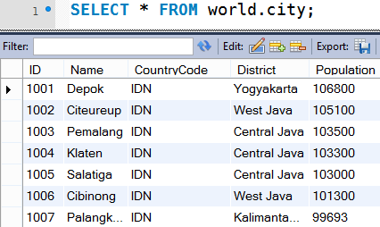

What is MySQL?
MySQL
MySQL is open-source DB server (RDBMS)
World's most-popular open-source database
Used to power web sites and small apps
Free and paid editions
Community Server, Enterprise, Cluster CGE
MariaDB
Community-driven fork of the MySQL server

Slide 6
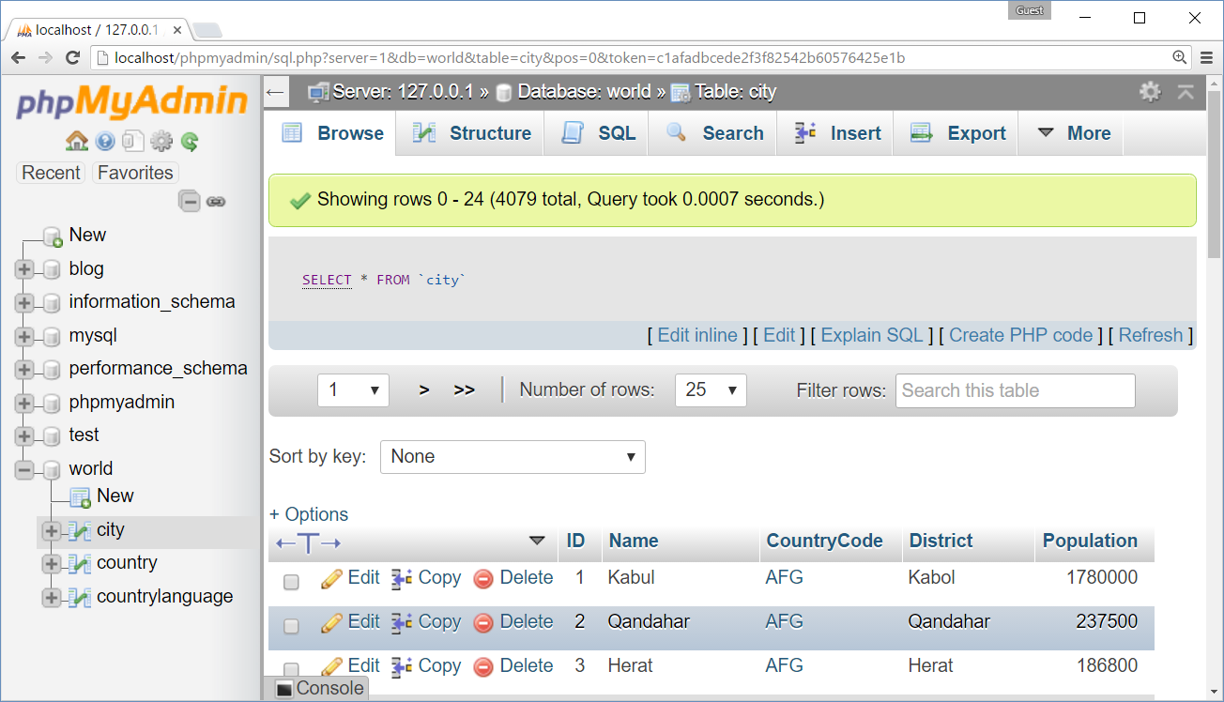
phpMyAdmin – Web Based MySQL Admin

Slide 7
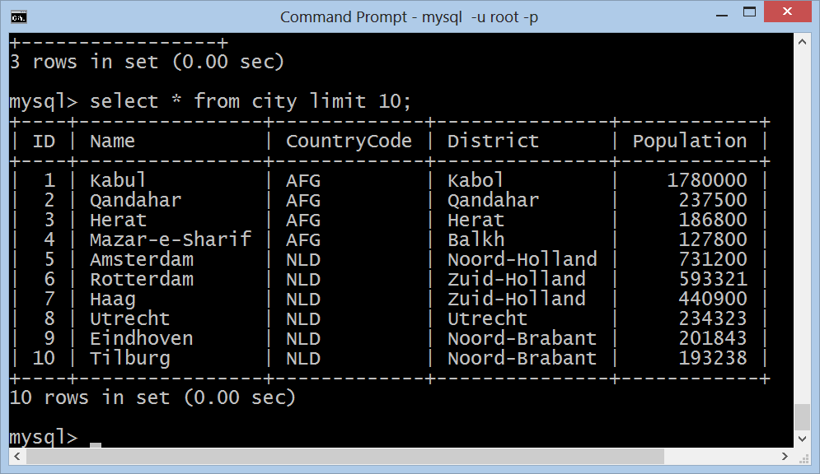
MySQL Console Client
mysql –u root -p

Slide 8
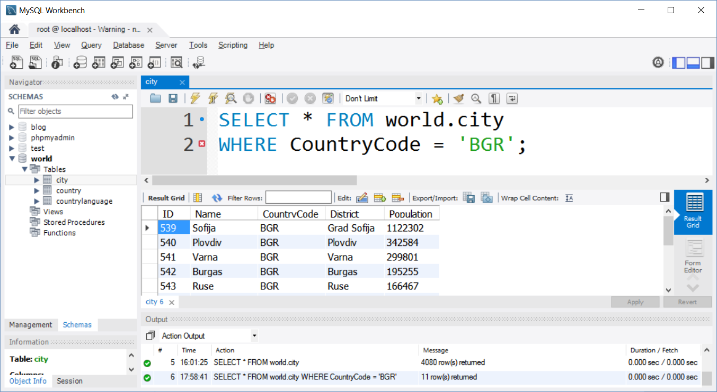
MySQL Workbench – Free Desktop Admin

Slide 9
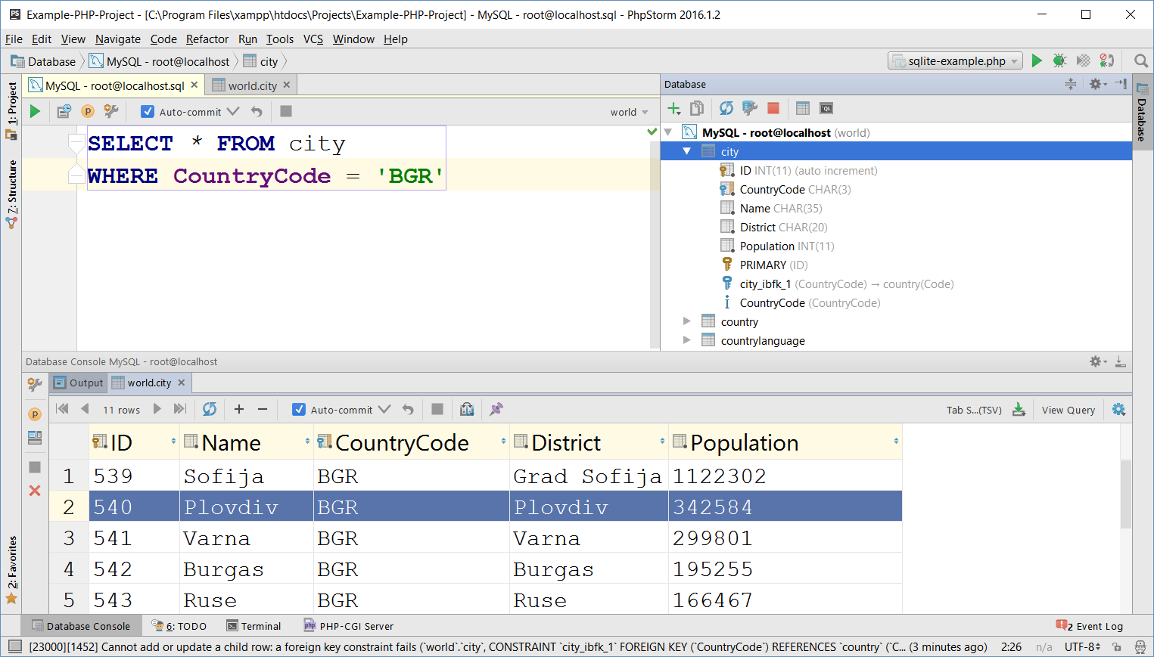
MySQL and PhpStorm

Slide 10
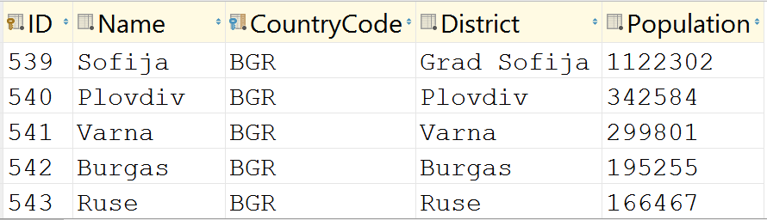
Databases and Tables
Databases (DB schemas)
Hold set of tables with relationships
Tables hold data organized in rows and columns
Table column
Table row

Slide 11
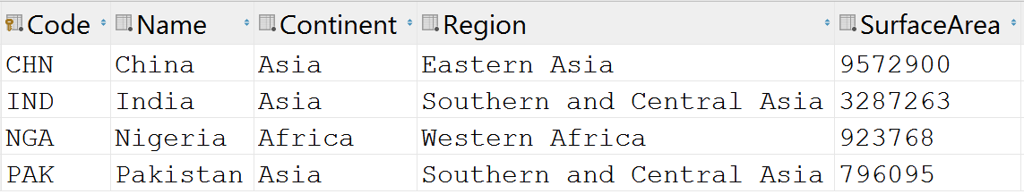

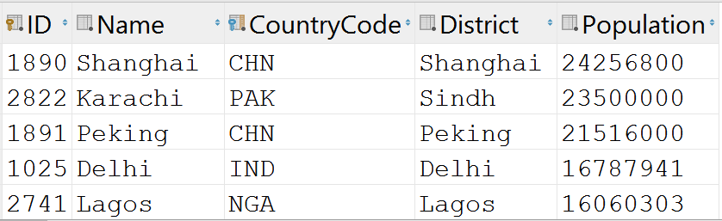
Relationships
Primary key column
Foreign key column
Relationship (foreign key)

Slide 12
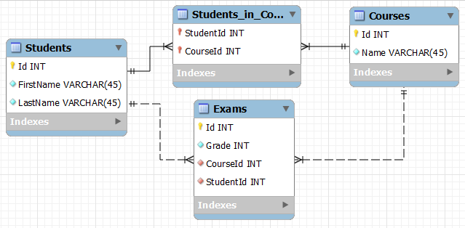
Database Schema
Database schema defines the table structure and relationships
Visualized as database diagram (E/R diagram)

Slide 13
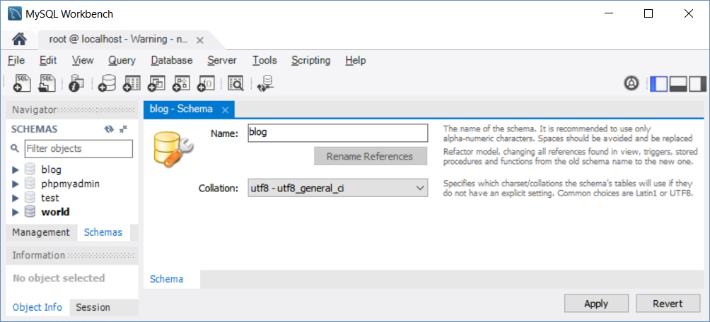
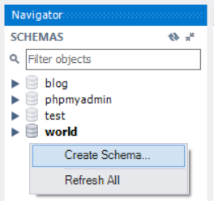
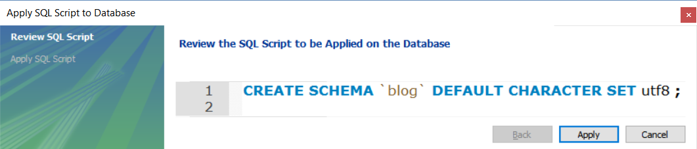
Create a Database in MySQL
Prefer UTF-8 based collation

Slide 14
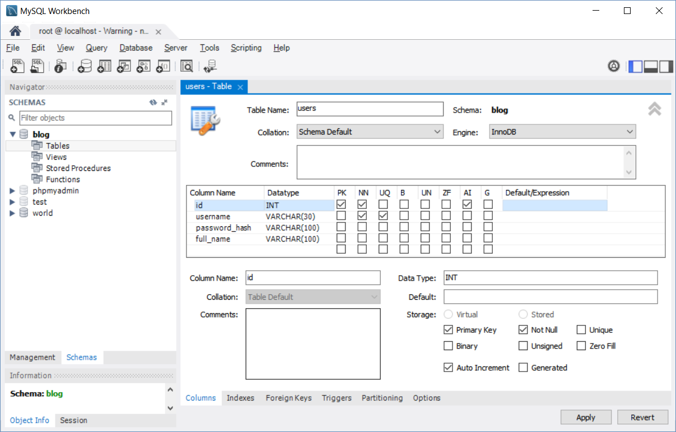
Create a Table in MySQL Database

Slide 15
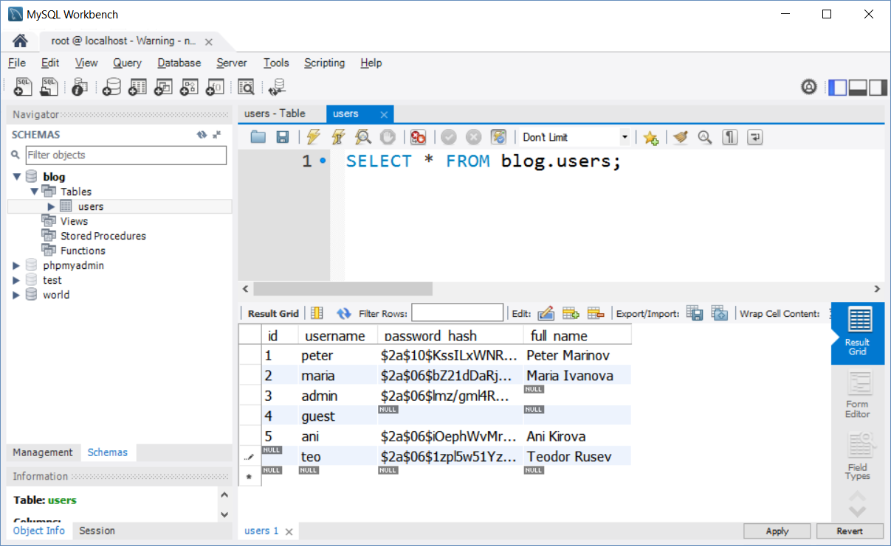
Insert Data Rows in a Table

Slide 16
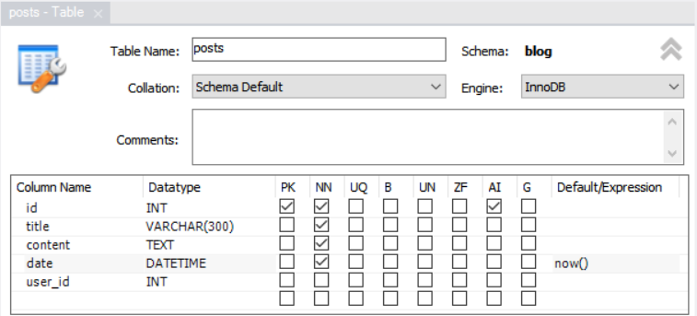
Create Related Table (with Relationship)

Slide 17
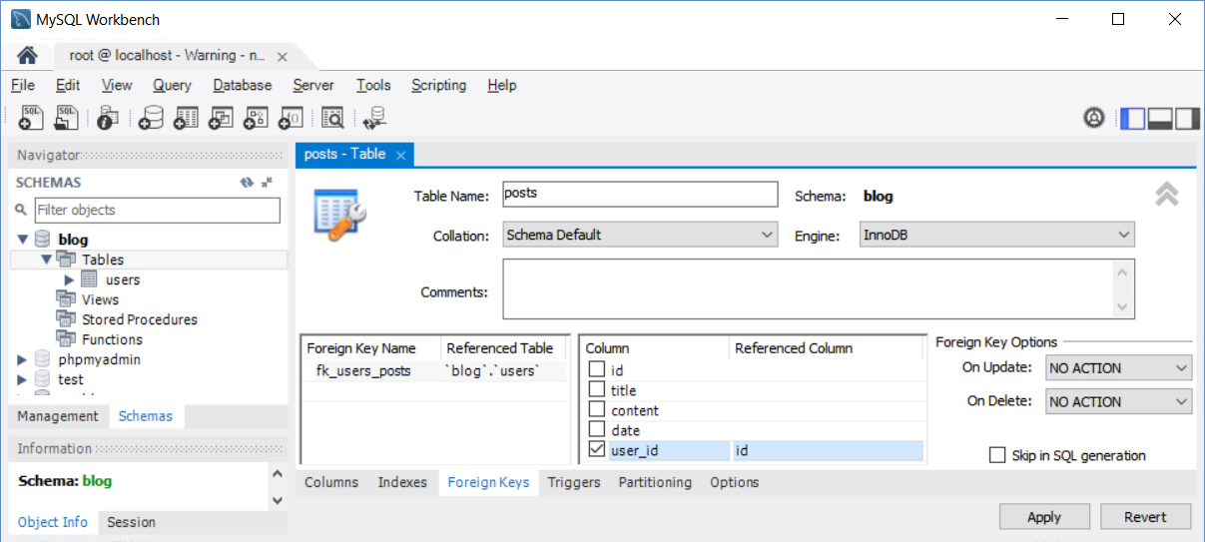
Create Foreign Key Relationship

Slide 18
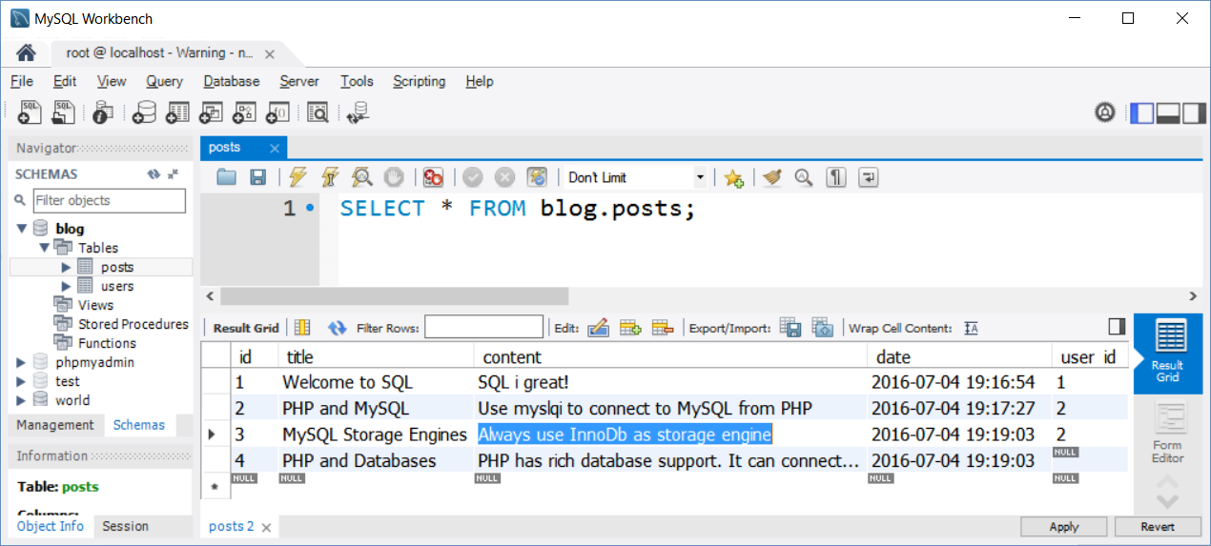
Insert Related Rows in the Second Table

Slide 19
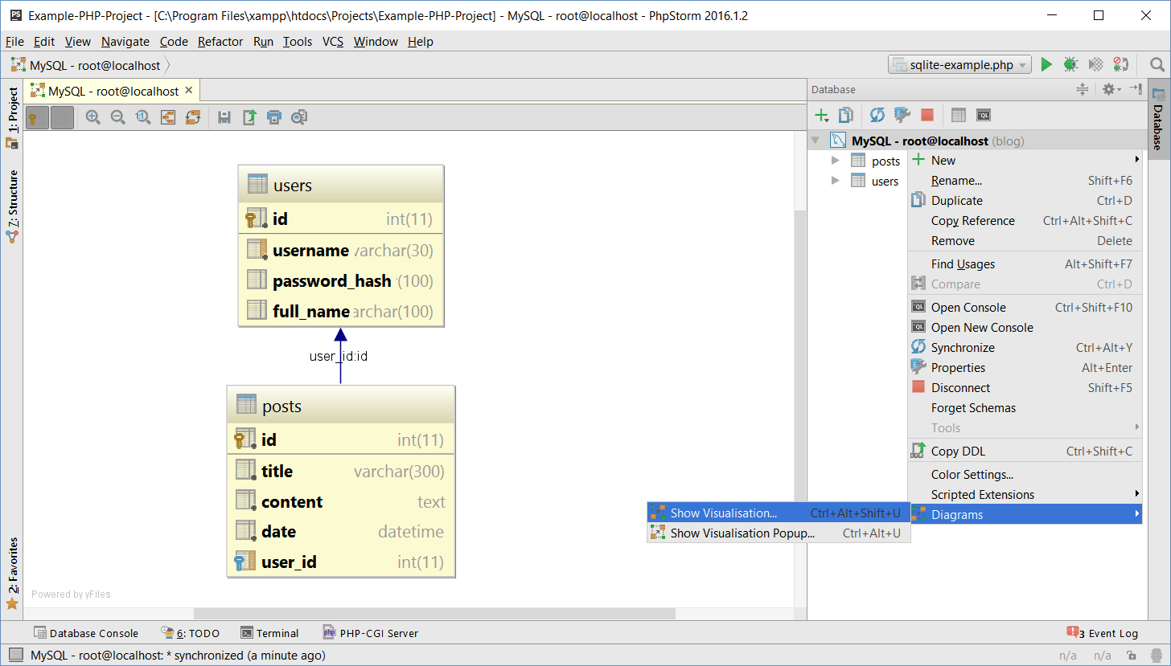
Blog Database in MySQL – DB Diagram

Slide 20
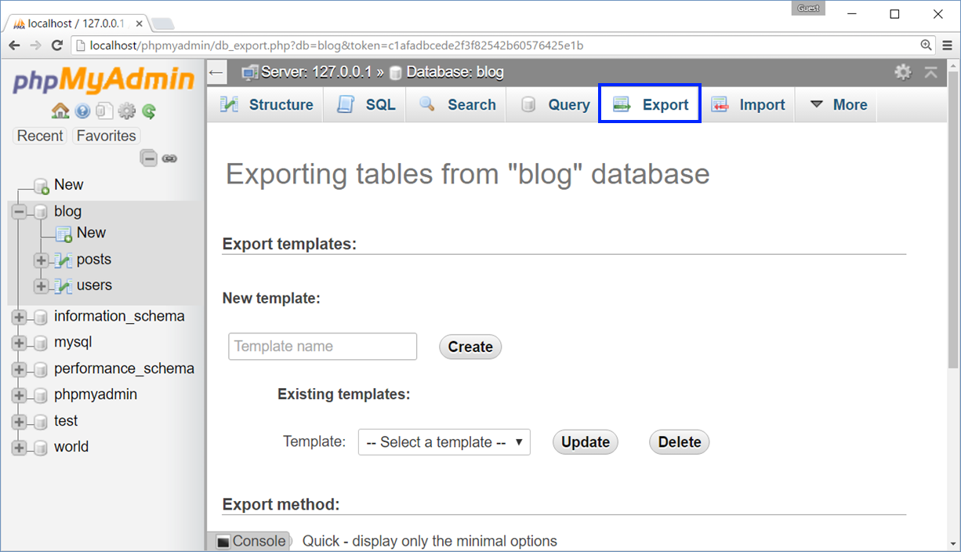
Backup Database as SQL Script
Backup database as SQL script using phpMyAdmin

Slide 21
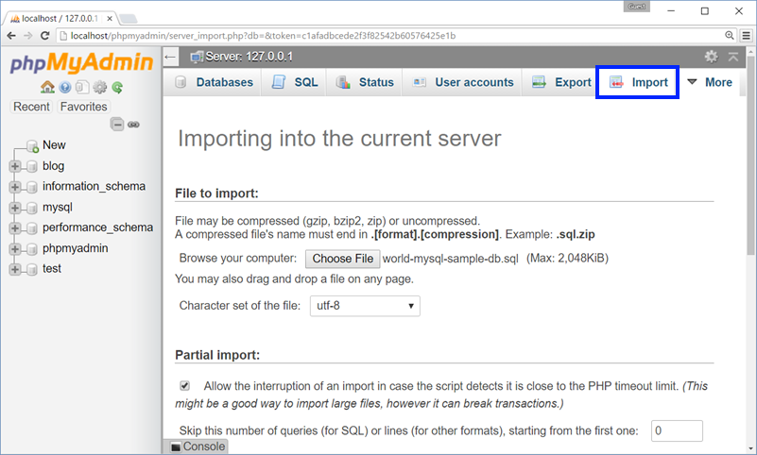
Restore Database from SQL Script
Restore database from SQL script using phpMyAdmin

Slide 22
Creating Tables in MySQL
Create table users(id, username, password_hash, full_name). Use a tool of your choice.
Insert some sample data in the table.
Create table posts(id, title, content, date, user_id).
Create foreign key from posts to users.
Insert some sample data.
Live Exercise (Lab)

Slide 23
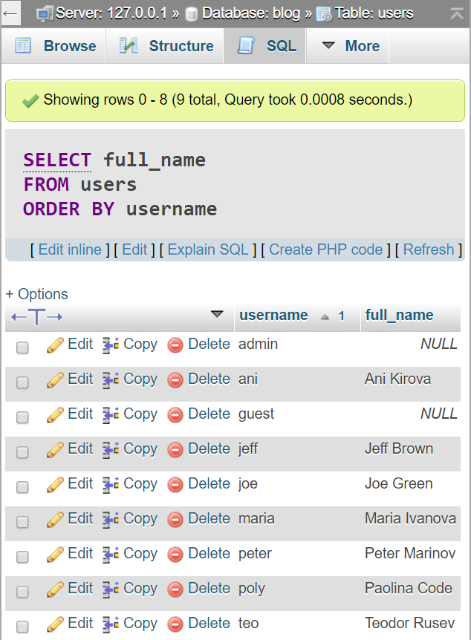



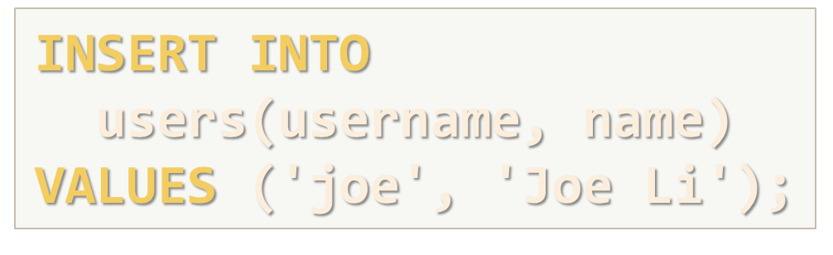


SQL – Introduction

Slide 24
SQL Language
SELECT
WHERE (filtering)
JOIN (joining tables)
GROUP BY (grouping)
INSERT
UPDATE
DELETE

Slide 25
SQL: SELECT, WHERE, ORDER BY
SELECT
WHERE
ORDER BY
SELECT username, full_name
FROM users
SELECT * FROM users
SELECT * FROM users
WHERE full_name LIKE 'M%'
OR full_name LIKE 'P%'
SELECT * FROM users
WHERE username = 'teo'
SELECT * FROM users
ORDER BY full_name DESC
LIMIT 3
SELECT * FROM users
ORDER BY username

Slide 26
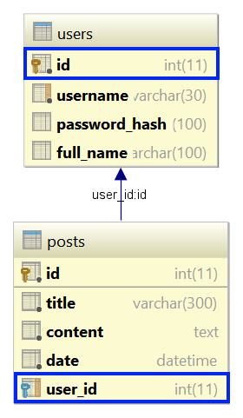
SQL: Join Tables
Join users with posts tables in SQL SELECT
SELECT *
FROM posts JOIN users
ON posts.user_id = users.id
SELECT p.title AS post,
u.username AS author
FROM posts p JOIN users u
ON p.user_id = u.id

Slide 27
SQL: INSERT
Insert a new post (id and date will be auto-generated)
Insert a few new users without passwords
INSERT INTO posts(title, content, user_id)
VALUES ('New Title', 'New post content', 3)
INSERT INTO users(username, full_name) VALUES
('joe', 'Joe Green'),
('jeff', 'Jeff Brown'),
('poly', 'Paolina Code')

Slide 28
SQL: UPDATE
Update existing post → change title
Update existing post → change date
UPDATE posts
SET title = 'Title Updated!'
WHERE id = 2;
UPDATE posts
SET date = STR_TO_DATE('31-12-2016', '%d-%m-%Y')
WHERE YEAR(date) = 2016;

Slide 29
SQL: DELETE
Delete existing post
Delete all posts from user joe
DELETE FROM posts
WHERE id = 6;
DELETE FROM posts
WHERE user_id =
(SELECT id FROM users
WHERE username = 'joe');

Slide 30
SQL Commands
Write SQL INSERT to create a new user (username 'pesho', password '$xyz', name 'Peter Ivanov').
Write SQL UPDATE to change user 'pesho' to 'pepi'.
Write SQL SELECT to show all users that start with 'p'.
Write SQL INSERT to create a new post from user 'pepi'.
Write SQL SELECT to show all posts from user 'pepi'.
Write SQL DELETE to remove all posts from user 'pepi'.
Live Exercise (Lab)

Slide 31
Accessing MySQL from PHP
+
Using mysqli

Slide 32
Using MySQL in PHP: Connect & Query
Use mysqli class to connect to MySQL from PHP script
Execute a SQL query through existing MySQL connection
$mysqli =
new mysqli('localhost', 'root', '', 'blog');
$mysqli->set_charset("utf8");
if ($mysqli->connect_errno) die('Cannot connect to MySQL');
$result = $mysqli->query('SELECT * FROM posts');
if (!$result)
die('Cannot read `posts` table');

Slide 33
Using MySQL in PHP: Fetch Records
Process the returned result set (table rows / records)
$result =
$mysqli->query('SELECT * FROM posts');
while ($row = $result->fetch_assoc()) {
$title = $row['title'];
// TODO: print the title
$content = $row['content'];
// TODO: print the content
}

Slide 34
Using MySQL in PHP: Prepared Statement
Using a prepared statement with parameters
function deletePost($mysqli, $id) {
$statement = $mysqli->prepare(
"DELETE FROM posts WHERE id = ?");
$statement->bind_param("i", $id);
$statement->execute();
return $statement->affected_rows > 0;
}
Param types: s – string i – integer d – double

Slide 35
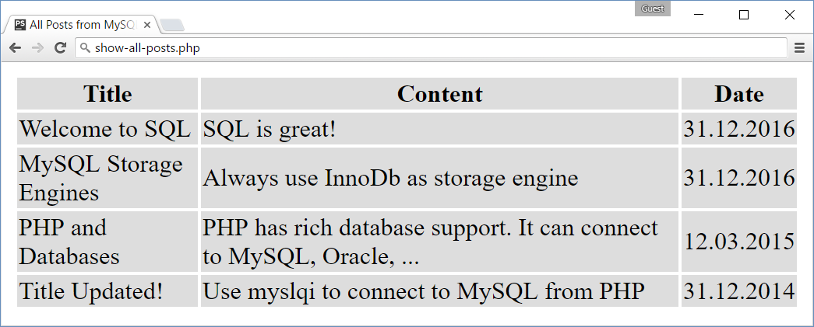
Problem: List Posts from MySQL
Write PHP script to list all posts from MySQL database
Format the posts in a HTML table

Slide 36
Solution: List Posts from MySQL
$mysqli = new mysqli('localhost', 'root', '', 'blog');
$mysqli->set_charset("utf8");
if ($mysqli->connect_errno) die('Cannot connect to MySQL');
$result = $mysqli->query('SELECT * FROM posts ORDER BY date');
if (!$result) die('Cannot read `posts` table from MySQL');
echo "<table>\n";
echo "<tr><th>Title</th><th>Content</th><th>Date</th></tr>\n";
while ($row = $result->fetch_assoc()) {
$title = htmlspecialchars($row['title']);
$body = htmlspecialchars($row['content']);
$date = (new DateTime($row['date']))->format('d.m.Y');
echo "<tr><td>$title</td><td>$body</td><td>$date</td></tr>\n";
}
echo "</table>\n";

Slide 37
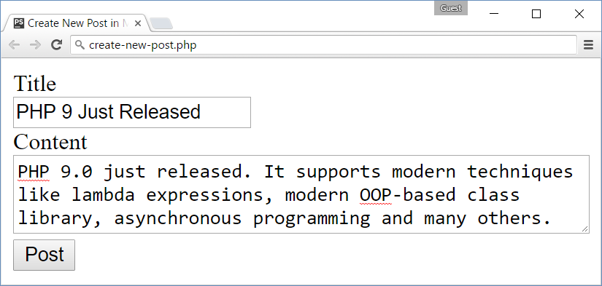
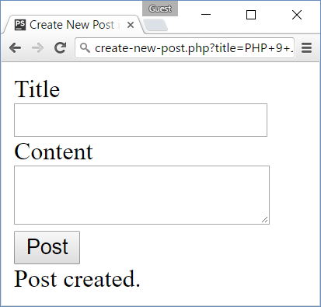
Problem: Create New Post in MySQL
Write PHP script to create a new post in MySQL database
Use a HTML form holding title + content (empty author)

Slide 38
Solution: Create New Post in MySQL
<form>
<div>Title</div>
<input type="text" name="title">
<div>Content</div>
<textarea name="content"></textarea>
<div><input type="submit" value="Post"></div>
</form>
<!-- TODO: process the form here ->

Slide 39
Solution: Create New Post in MySQL (2)
if (isset($_GET['title'])) {
$mysqli = new mysqli('localhost', 'root', '', 'blog');
$mysqli->set_charset("utf8");
$stmt = $mysqli->prepare(
"INSERT INTO posts(title, content) VALUES (?, ?)");
$stmt->bind_param("ss",
$_GET['title'], $_GET['content']);
$stmt->execute();
if ($stmt->affected_rows == 1)
echo "Post created.";
else die("Insert post failed.");
}

Slide 40
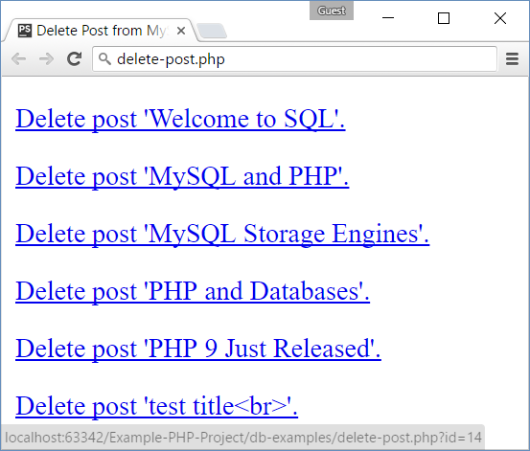
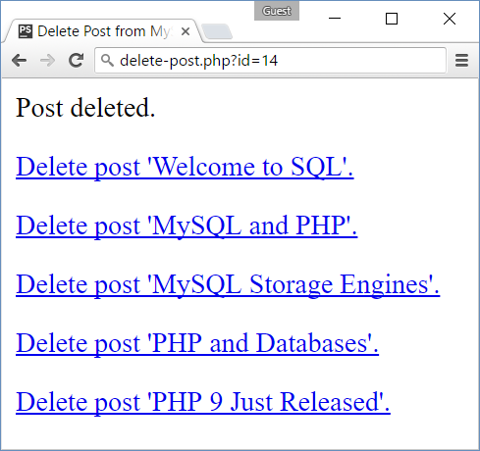
Problem: Delete Existing Post from MySQL
Write PHP script to delete existing post from MySQL database

Slide 41
Solution: Delete Existing Post from MySQL
$mysqli = new mysqli('localhost', 'root', '', 'blog');
$mysqli->set_charset("utf8");
if (isset($_GET['id'])) {
$st = $mysqli->prepare("DELETE FROM posts WHERE id = ?");
$st->bind_param("i", $_GET['id']);
$st->execute();
if ($st->affected_rows == 1) echo "Post deleted.";
}
$result = $mysqli->query('SELECT id, title FROM posts');
while ($row = $result->fetch_assoc()) {
$title = htmlspecialchars($row['title']);
$delLink = 'delete-post.php?id=' . $row['id'];
echo "<p><a href='$delLink'>Delete post '$title'.</a></p>";
}

Slide 42

Summary
MySQL is a relational database (RDBMS)
MySQL DB holds data in tables
Tables can have relationships
SQL is standard language for most databases
Query data: SQL SELECT, WHERE + table joins
Modify data: SQL UPDATE, DELETE, INSERT
Use mysqli to access MySQL from PHP
Query and modify data (prepared statement)

Slide 43








MySQL for PHP Developers
https://softuni.bg/courses/software-technologies

Slide 44
License
This course (slides, examples, demos, videos, homework, etc.) is licensed under the "Creative Commons Attribution-NonCommercial-ShareAlike 4.0 International" license

Slide 45






Free Trainings @ Software University
Software University Foundation – softuni.org
Software University – High-Quality Education, Profession and Job for Software Developers
softuni.bg
Software University @ Facebook
facebook.com/SoftwareUniversity
Software University @ YouTube
youtube.com/SoftwareUniversity
Software University Forums – forum.softuni.bg

